Slide 1
CSE315:Introduction to Data Science Feature Engineering
WEEK-??

Slide 2
Feature Engineering
Feature engineering is the process of extracting meaningful features from raw data. We can experiment with different features based on our domain knowledge or understanding of the data.
There are mainly four different ways to do feature engineering:
Feature Transformation (FT)
Feature Construction
Feature Selection
Feature Extraction
1. Feature Transformation
Feature transformation is the process of modifying features to make them more suitable for machine learning algorithms." It includes
Handling missing values,
Handling categorical values (converting categorical features to numerical values)
Detecting outliers, and
Calling features to a standard or common range.

Slide 3
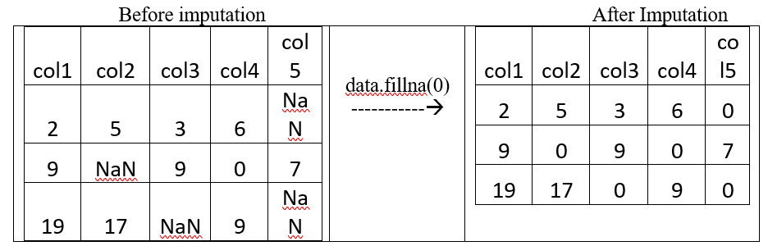
Handling Missing Values
Missing values can crash our data and ruin the model due to overlooking them.
There are two main approaches to handling missing values:
Imputation: This is like filling in the blanks with estimates. We can use the mean, median, or mode of the nearest values, or we can use some logic to fill in the blanks.
Python Code:
#file: cse315_1.py
#data file impu.csv
import pandas as pd
data1 = pd.read_csv("C:/Users/HP/Desktop/ddd/impu.csv")
impudat=data1.fillna(0)
print(" Before imputation",data1,sep='\n')
print(" After imputation",impudat,sep='\n')

Slide 4
Deletion
Deletion: We can remove the rows or columns with missing values.
#file: cse315_del.py
#data file deletion.csv
import pandas as pd
dele = pd.read_csv("C:/Users/HP/Desktop/ddd/deletion.csv")
#deldat=dele.dropna(inplace=False)
deldat=dele.dropna(inplace=False)
print(" Before deletion",dele,sep='\n')
print(" After deletion",deldat,sep='\n')
User | Device | OS | Transactions
A | Mobile | NA | 5
B | Mobile | Android | 3
C | NA | IOS | 2
D | Tablet | Android | 1
E | Mobile | IOS | 4

Slide 5
Encoding: Handling Categorical Variable
Data can be divided into numerical (quantitative) and categorical (qualitative). Categorical data can be divided into nominal and ordinal data. Depending on the data type, there are different ways to convert categorical data to numerical data. This process is called encoding.
Encoding refers to the process of converting categorical data into a numerical format.

Slide 6
One-hot encoding
By far the most common way to represent categorical variables is using the one-hot encoding or one-out-of-N encoding, also known as dummy variables.
One Hot Encoder is a popular encoder through which categorical variables can be converted into separate columns and their presence can be expressed in each column by Boolean True/False or 0/1.
This is encoded by the OneHotEncoder function, but we will see its application in the following example by its dummy variable using the get_dummies function.
For example, we created two separate columns for OWN_OCCUPIED columns 1 and 2 and expressed the value of the columns by 0/1.
#One Hot Encoding for nominal data
Import pandas as pd
df=……..
df1 = pd.get_dummies(df, columns=['OWN_OCCUPIED'])
df1

Slide 7
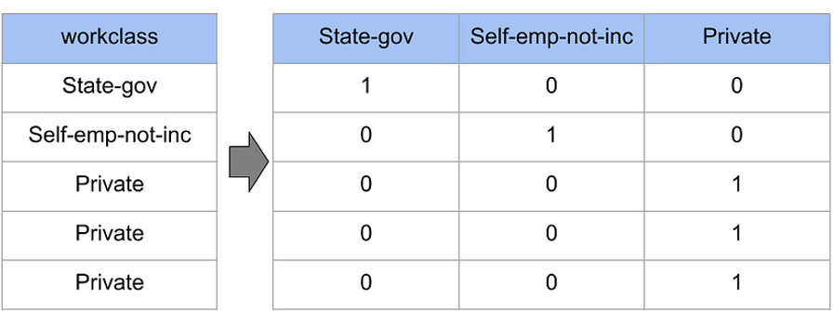
Example of one-hot coding
Example 1
Example 2: Consider the data where fruits, their corresponding categorical values, and prices are given.
➔
Fruit | Categorical value of fruit | Price
apple | 1 | 5
mango | 2 | 10
apple | 1 | 15
orange | 3 | 20
apple | mango | orange | price
1 | 0 | 0 | 5
0 | 1 | 0 | 10
1 | 0 | 0 | 15
0 | 0 | 1 | 20

Slide 8
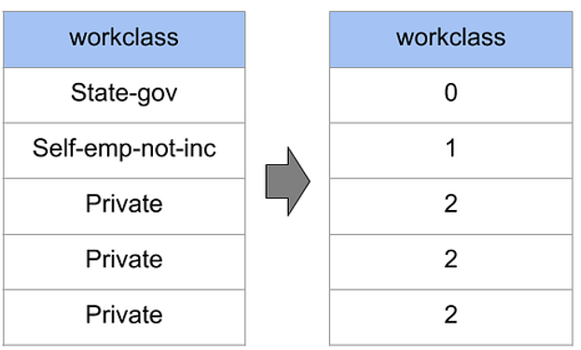
Ordinal Encoding
Ordinal data can be converted to ordinal encoding.
Example:

Slide 9
Data Transformation
Data transformation is an important issue for machine learning.
Suppose you have a dataset that contains some people's age and income data. The age range of human beings is usually from 0 to 100, in fact it is seen that those who earn may be between 25 and 60 years of age.
On the other hand, the amount of income can be from a few thousand to a few lakhs. So it is clear to us that there is a big difference between the age range and the income range. Sometimes such differences can cause the model to be biased.
Also, scaling the data increases the performance of the model, in many cases it takes less time to run the model.
Many people also call data transformation as feature engineering.

Slide 10
Label Encoding
One-hot and Ordinal encoders can be used for explanatory/independent variables (x). For prediction/target variables (y), we use label encoding, specially designed for output or target variables.
Label encoding is a method of processing categorical data. In this method we can express all the unique values ​​of categorical variables with different numbers.
Suppose you have a dataset where male or female is written as human gender. We can express the males by 1 and the females by 2 by encoding the label.
It is also called dummy variable. The code below shows that the ST_NAME variable is a categorical variable, with different road names.
Through label encoding we have expressed the name of each unique road by a different number. Then when the dataset is shown again, we see that all the roads (unique) are expressed by different numbers.
from sklearn.preprocessing
import LabelEncoder
le = LabelEncoder()
df['ST_NAME']= le.fit_transform(df['ST_NAME'])
df

Slide 11
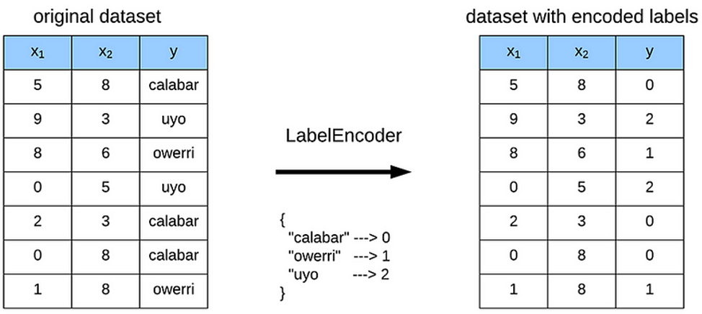
Example of label encoding

Slide 12
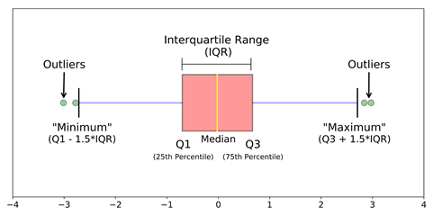
Handling Outliers
Outliers are data points significantly different from the rest of the data set. They can affect the accuracy of our model.
There are two main ways to treat outliers:
Trimming: We can remove the outliers from the data set.
Capping: We can replace the outliers with values within the range of the rest of the data.
If the outliers are a small number, e can trim them. But if the outliers are significant, we might cap them.
Several methods can be used to detect and remove outliers, including z-score, IQR, percentile, and Winsorization.

Slide 13
Mapping Function
We can also convert data from numerical to categorical or categorical to numerical through the mapping function. In the following example we have mapped Y to 1 and N to 2 of the OWN_OCCUPIED column.
#use of mapping function
mapping = {'Y' :1 , 'N' : 2 }
df['OWN_OCCUPIED'] = df['OWN_OCCUPIED'].map(mapping)
df

Slide 14
Feature scaling
Feature scaling is a process of transforming the features in a dataset to have a common scale. This helps to prevent certain features from dominating the model.
There are two main types of feature scaling:
Standardization
Normalization

Slide 15
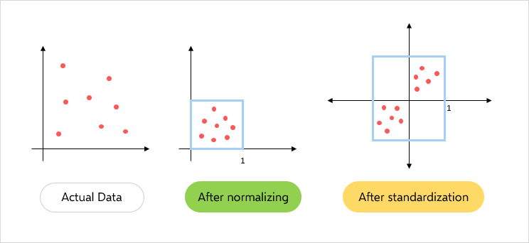
FeatureScaling
Feature scaling is an essential step in the machine-learning process. By scaling the features, we can help improve your model's performance and ensure that all features are given a fair chance.

Slide 16
Standardization
Standardization: Standardization subtracts each feature's mean and divides it by the standard deviation. This ensures that each feature has a mean of 0 and a standard deviation 1. Standardization is often used for data that follows Gaussian distribution, such as linear regression.
A value is standardized as follows:
We can guesstimate a mean of 10.0 and a standard deviation of about 5.0. Using these values, we can standardize the first value of 20.7 as follows:
y = (x – mean) / standard_deviation
y = (20.7 – 10) / 5= (10.7) / 5= 2.14
The mean and standard deviation estimates of a dataset can be more robust to new data than the minimum and maximum.

Slide 17
Normalization
The data normalization (also referred to as data pre-processing) is a basic element of data mining. It means transforming the data, namely converting the source data in to another format that allows processing data effectively. The main purpose of data normalization is to minimize or even exclude duplicated data.

Slide 18
Normalization Technique
Min-Max Normalization
Robust Scaling Normalization
Z-score Normalization
Decimal Scale Normalization
Log Scale Normalization

Slide 19
Min-Max Normalization
Min-max scaling is very often simply called ‘normalization.’ It transforms features to a specified range, typically between 0 and 1. The formula for min-max scaling is:
X_{normalized} =(X – X_{min} ) / (X_{max} – X_{min} ),
where X is a random feature value that is to be normalized. X_{min} is the minimum feature value in the dataset, and X_{max} is the maximum feature value.
Salary
64000
55000
19000
100000
75000
Apply min max normalization for the salary value of 64000 and 55000
Max distance for salary = 100000 Min distance for salary = 19000

Slide 20
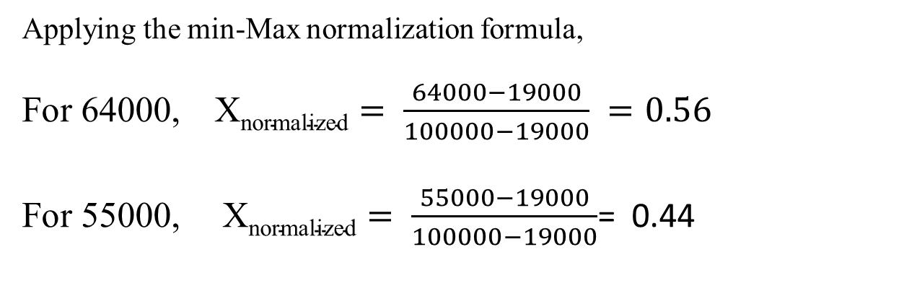
Min-Max Normalization
Applying the min-Max normalization formula,
For 64000, $\text{X}\text{normalized}= \frac{64000−19000}{100000−19000} =0.56$
For 55000, $\text{X}\text{normalized}= \frac{55000−19000}{100000−19000}$= 0.44
Min-max scaling is a good choice when:
The approximate upper and lower bounds of the dataset are known, and the dataset has few or no outliers
When the data distribution is unknown or non-Gaussian, and the data is approximately uniformly distributed across the range
When maintaining the distribution’s original shape is essential

Slide 21
Robust Scaling Normalization
Both standard and robust scalers transform inputs to comparable scales. The difference lies in how they scale raw input values. Robust scaling answers a simple question. How far is each data point from the input’s median? More precisely, it measures this distance in terms of the IQR using the below formula:
The scaled values will have their median and IQR set to 0 and 1, respectively. The fact that robust scaling uses median and IQR makes it resistant to outliers. Since robust scaling is resilient to the influence of outliers, this makes it suitable for datasets with skewed or anomalous values or with outliers.
Example: Original value =30, Input’s median= 25, IQR = 20
Robust scaled value = (30-28)/20=0.10

Slide 22
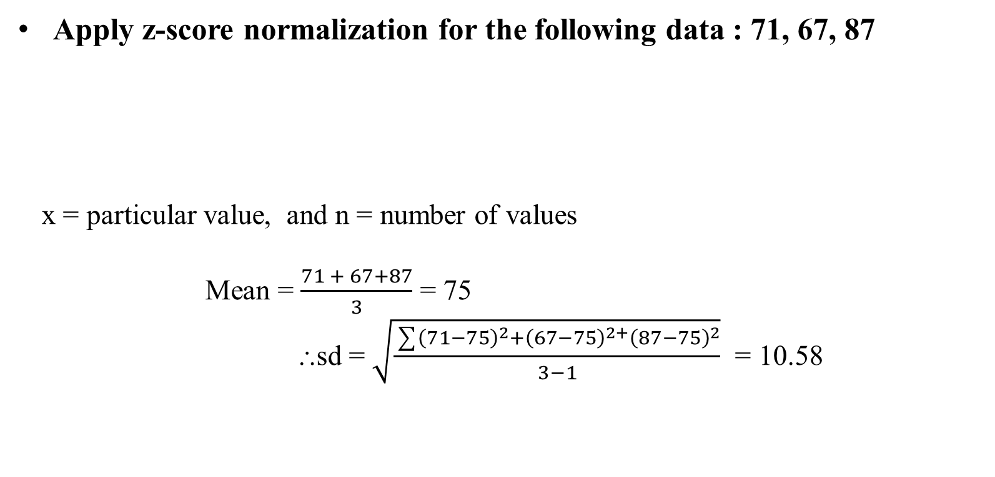
Z-Score Normalization
Apply z-score normalization for the following data : 71, 67, 87
x = particular value, and n = number of values
Mean = $\frac{71 + 67+87}{3}$ = 75
⸫sd = $\sqrt{\frac{\sum{{\left(71−75\right)}^{2}{+\left(67−75\right)}^{2+}{\left(87−75\right)}^{2}}}{3−1}}$ = 10.58

Slide 23

Z-Score Normalization
After applying the formula $z= \frac{x −mean}{sd}$ we get,
For 71,
$z= \frac{71 −75}{10.583}$ = -0.37780
For 67,
z $= \frac{67 −75}{10.583}$ = -0.7559
For 67,
z $= \frac{87 −75}{10.583}$ = 1.1339

Slide 24
Decimal Scale Normalization
Decimal scaling normalization aims to scale the feature values by a power of 10, ensuring that the largest absolute value in each feature becomes less than 1. It is useful when the range of values in a dataset is known, but the range varies across features. The formula for decimal scaling normalization is:
X_{decimal} = X / 10^{d}
X is the original feature value, and d is the smallest integer such that the largest absolute value in the feature becomes less than 1.
For example, if the largest absolute value in a feature is 350, then d would be 3, and the feature would be scaled by 10³.
Decimal scaling normalization is advantageous when dealing with datasets where the absolute magnitude of values matters more than their specific scale.

Slide 25
Decimal Scale Normalization
CGPA | Formula | After Decimal Normalization
2 | 2/10 | 0.2
3 | 3/10 | 0.3
Money | Formula | After Decimal Normalization
500 | 500/1000 | 0.5
320 | 320/1000 | 0.32
Salary | Formula | After Decimal Normalization
32000 | 32000/100000 | 0.32
28000 | 28000/100000 | 0.28

Slide 26
Log scaling normalization
Log scaling normalization converts data into a logarithmic scale by taking the log of each data point.
It is particularly useful when dealing with several orders of magnitude data. The formula for log scaling normalization is:
X_{log} = log(X)
This normalization comes in handy with data that follows an exponential growth or decay pattern. It compresses the scale of the dataset, making it easier for models to capture patterns and relationships in the data.
Population size over the years is a good example of a dataset where some features exhibit exponential growth. Log scaling normalization can make these features more amenable to modelling.
Example: X =200, X_{log} =2.30103

Slide 27
Comparison of normalization (min-max scaling) and standardization
.
Normalization | Standardization
The objective is to bring the values of a feature within a specific range, often between 0 and 1 | The objective is to transform the values of a feature to have a mean of 0 and a standard deviation of 1
Sensitive to outliers and the range of the data | Less sensitive to outliers due to the use of the mean and standard deviation
Useful when maintaining the original range is essential | Effective when algorithms assume a standard normal distribution
No assumption about the distribution of data is made | Assumes a normal distribution or close approximation
Suitable for algorithms where the absolute values and their relations are important (e.g., k-nearest neighbors, neural networks) | It is particularly useful for algorithms that assume normally distributed data, such as linear regression and support vector machines.
Maintains the interpretability of the original values within the specified range | Alters the original values, making interpretation more challenging due to the shift in scale and units
This can lead to faster convergence, especially in algorithms that rely on gradient descent | It also contributes to faster convergence, particularly in algorithms sensitive to the scale of input features.
Use cases: Image processing, neural networks, algorithms sensitive to feature scales | Use cases: Linear regression, support vector machines, algorithms assuming a normal distribution

Slide 28
Which procedure is appropriate for when?
It is difficult to say when to use any kind of transformation. Depending on the type of problem.
Data scaling is very important in case of distance based algorithms like SVM, KNN, clustering etc.
On the other hand, non-distance based algorithm is not very important in case of naive-bayes, various tree based algorithms.
The normalization brings the data on a scale from 0 to 1 Standardization,
on the other hand, brings data within Min 0 and Standard Deviation 1.
Normalization can be used if there is a large difference in the range of values ​​of the dataset feature.
Standardization works well if there is an outlier in the data.
However, in most cases, standardization works well overall.

Slide 29
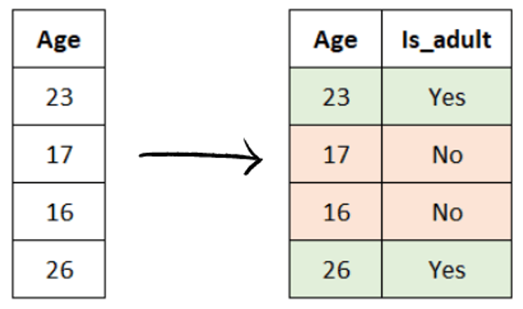
Feature Construction
The process of developing new features from existing features or upon our domain knowledge is known as feature construction.
Making the features more informative and relevant to the task helps machine learning models perform better.

Slide 30
Feature Construction
There are numerous ways to build features, but some typical techniques include:
Repurposing existing features: This is like remixing old songs. We can combine existing features in new ways to create something new and exciting. Combine, alter, or create new features from existing ones. For example, you could combine the features "sibsp" and "parch" in the Titanic dataset to create a new feature called "family."
Using domain expertise: This is like consulting a chef. You can use your domain understanding to create new features essential to the task. Create new features that are important to the task based on our domain knowledge. For example, if you are developing a model to predict customer churn, you could add a new feature called "number of months since last purchase" if you know that customers who haven't purchased in a while are more likely to churn.
Using feature selection algorithms: This is like hiring a personal shopper. You can use these algorithms to determine the most important features from a data set and then build new features based on those features. It's like curating the best attributes to create powerful new ones!

Slide 31
Feature Extraction
Feature extraction is a process of reducing the dimensionality of data by identifying the most essential features.
The more features we have, the harder it is to find the important ones. "The curse of dimensionality occurs when the dataset contains an excessive number of features, making it difficult for Machine Learning algorithms to identify essential features." Dimensionality Reduction can be helpful in such a situation.
"Dimensionality reduction is a process of simplifying a dataset by reducing the number of features or dimensions. This can be done to improve the efficiency and accuracy of machine learning models."
Dimensionality reduction can be done in two ways:
Feature Extraction
Feature Selection

Slide 32
Feature Extraction
The most frequently used approaches for dimensionality reduction are:
Principal Component Analysis(PCA)
Linear Discriminant Analysis(LDA)
T-distributed Stochastic Neighbor Embedding (T-SNE)
In feature selection, we choose a subset of features from the dataset to train machine learning algorithms while maintaining the original feature distribution.
However, when using dimensionality reduction techniques such as PCA, the original representation of the variables is altered.

Slide 33
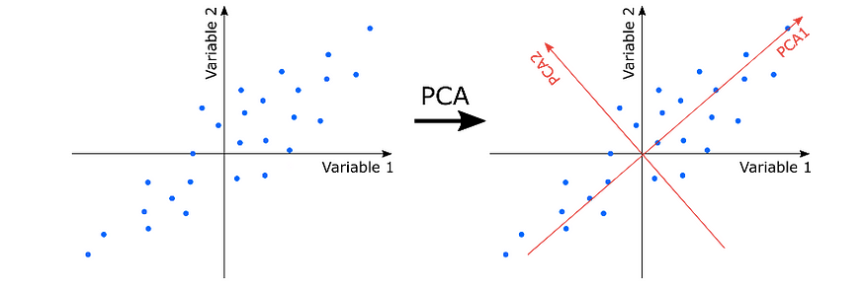
Feature Extraction: Principal Component Analysis
Principal Component Analysis(PCA)
PCA is an unsupervised technique that reduces the dimensionality of data by finding the directions (called Principal Components) that capture the most variance in the data.

Slide 34
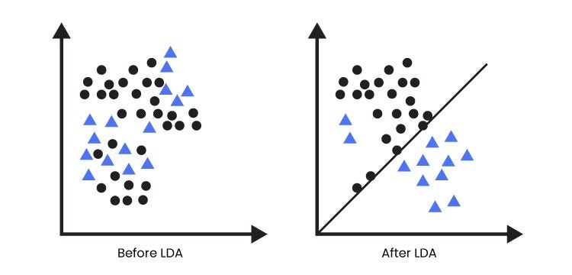
Feature Extraction: Linear Discriminant Analysis(LDA)
LDA is a supervised machine learning algorithm that seeks to find the directions in the data that best separate the different known categories.

Slide 35
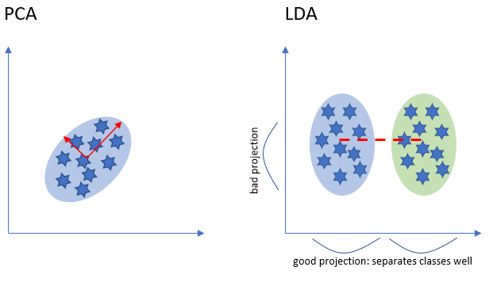
Feature Extraction: Linear Discriminant Analysis(LDA)
LDA is a supervised machine learning algorithm that seeks to find the directions in the data that best separate the different known categories.

Slide 36
Feaure Extraction: T-distributed Stochastic Neighbor Embedding(T-SNE)
T-SNE is a non-linear dimensionality reduction algorithm that can be used to separate data that a line cannot separate.
It does this by projecting the data into a lower dimension while preserving the clustering in the high-dimensional space

Slide 37
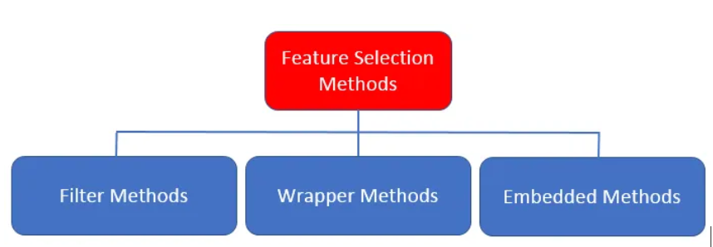
Feature Selection
Feature selection is the process of identifying and selecting the most important features in a dataset relevant to predicting the target variable.
There are mainly three techniques used for feature selection:
Filter methods
Wrapper methods
Embedded methods.

Slide 38
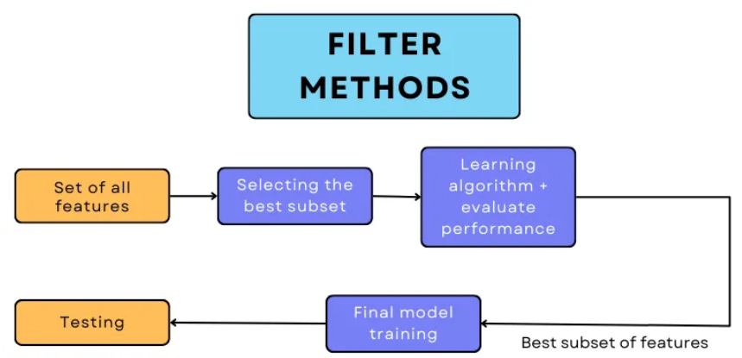
Feature Selection: Filter methods
Filter methods select features based on a statistical measure, and they do this by focusing on a single feature at a time and comparing it to the other features. The selection of features is not based on a learning algorithm.

Slide 39
Feature Selection: Filter Method
Filter methods can be done in the following ways:
Correlation: This method is like a couple on a blind date. They're a match made in heaven if they have a high correlation. But if they have a low correlation, they're better off going their separate ways.
This method calculates the correlation(using corr() ) between each feature and the target variable. If the correlation is below a certain value, we remove that feature from consideration, as it doesn't seem to impact the target variable significantly.
Variance threshold: If a feature has low variance, it's not very interesting, so it gets kicked out.
Chi-squared test: This method is like a detective. It looks for associations between two categorical variables and determines if they're guilty of being important features.
ANOVA: This method is like a judge in a courtroom. It looks at the means of multiple groups and decides if there's enough evidence to convict them of being essential features.

Slide 40
Feature Selection: Wrapper methods
Filter methods are a simple way to select features, but they do not consider the relationship between features. This can lead to the selection of features that are not relevant to the target variable.
The wrapper method is like a dating app for features. It takes many features out on dates with a machine learning algorithm and then sees which ones the algorithm likes the best. The feature that gets the most dates is the one that gets selected.
Wrapper method considers the relationship between features by training a machine learning algorithm on a subset of features and then evaluating the algorithm's performance."
This process is repeated for different subs
This process is repeated for different subsets of features, and the subset that results in the best performance is selected.

Slide 41
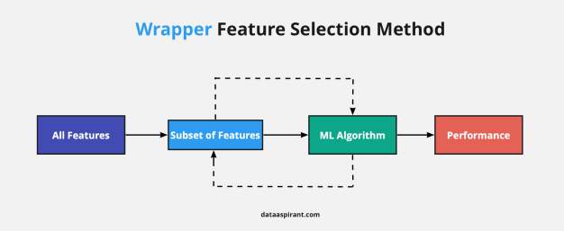
Feature Selection: Wrapper Method

Slide 42
Feature Selection: Wrapper methods cont.
There are several common techniques of wrapper methods, including:
Exhaustive Feature Selection/ Best Feature Selection
Sequential Forward Feature Selection
Sequential Backward Feature Selection
Exhaustive Feature Selection/ Best Feature Selection
"Exhaustive feature selection evaluates the performance of a machine learning algorithm on every possible subset of features, and then selects the subset that results in the best performance."
When we have n features, there are 2^n possible subsets of features.
As a result of this computational expense, other feature selection methods have been developed.

Slide 43
Wrapper methods
Forward Feature Selection
Forward Feature Selection starts with an empty set of features. It then adds the feature that most improves the accuracy of a machine learning algorithm."
The algorithm continues adding features until the accuracy of the algorithm no longer improves or until a maximum number of features is reached.
Backward Feature Selection
Backward feature selection is like the same chef who starts with a full pantry and then throws out the ingredients that make the dish taste the worst.
"Backward Feature Selection starts with all features included in the model. It then removes the feature that most decreases the accuracy of a machine learning algorithm."
The algorithm continues removing features until the accuracy of the algorithm no longer decreases or until a minimum number of features is reached.

Slide 44
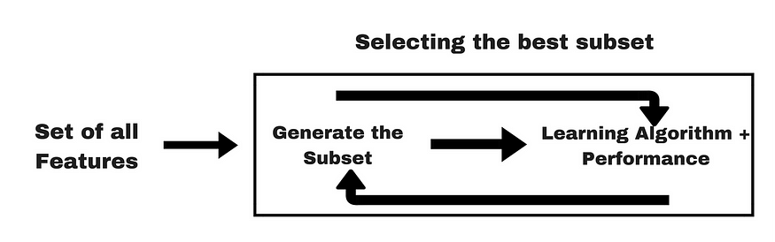
Wrapper methods: Embedded methods
"Embedded methods integrate the feature selection process into the machine learning algorithm itself.“
The most common types of embedded methods are,
Regularization
Tree Based algorithms
Regularization
"Regularization in embedded methods can be done by adding a regularization term to the loss function of the machine learning algorithm. "
The features with the largest coefficients will be penalized the most and may be excluded from the model.
Following regularization techniques are used
Lasso Regularization(L1):
Ridge Regularization(L2):
Elastic-Net Regularization(L1+L2):

Slide 45
Tree Based algorithms
Tree-based algorithms build a tree-like structure of decisions, where each decision is based on the importance of a feature."
The model will likely include the most essential features for splitting the data. Tree-based algorithms that can be used in embedded methods are,
Decision trees:
Random forests

Slide 46
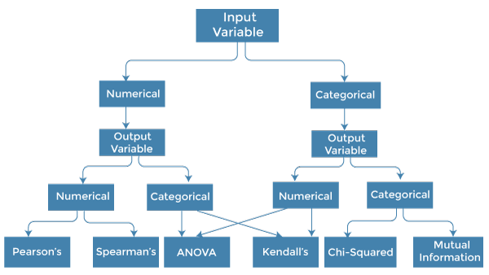

Slide 47
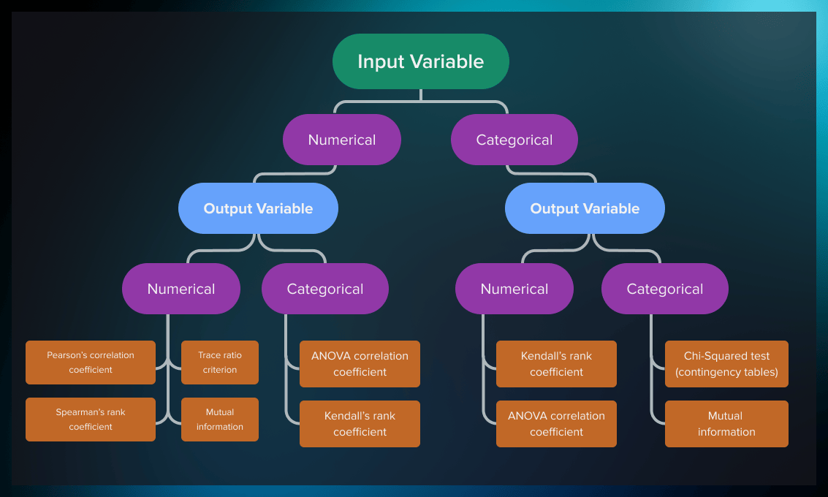
Test for feature selection
In the case of filter-based methods, statistical tests are used to determine the strength of correlation of the feature with the target variable. The choice of the test depends on the data type of both input and output variable (i.e. whether they are categorical or numerical.). You can see the most popular tests in the table below.

Slide 48
Test (cont)
Input | Output | Feature Selection Model
Numerical | Numerical | Pearson’s correlation coefficient Spearman’s rank coefficient Trace ratio criterion Mutual information
Numerical | Categorical | ANOVA correlation coefficient Kendall’s rank coefficient
Categorical | Numerical | Kendall’s rank coefficient ANOVA correlation coefficient
Categorical | Categorical | Chi-Squared test (contingency tables). Mutual Information.

Slide 49


